Slide 1
Introduction Presentation
Bahne Thiel-Peters
Supervisor:
Prof. Dr. Frano Matić

Slide 2
1
About me & my University
2
My Bachelor Thesis
3
My Master Thesis
4
Another project
5
My work in split

Slide 3
About me & my University
1

Slide 4


About me
General
24 years old
I love travelling
I did my last Erasmus Exchange in Malta
University
Exchange Student from Kiel (Germany)
Bachelor in Computer Science (CS)
Currently doing my Master in CS
https://commons.wikimedia.org/wiki/File:Blank_Map_of_Mediterranean_Sea_region.svg

Slide 5
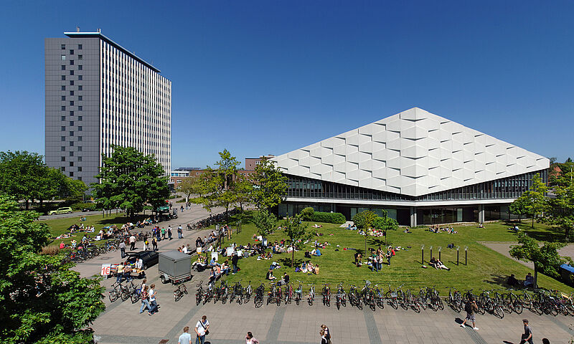
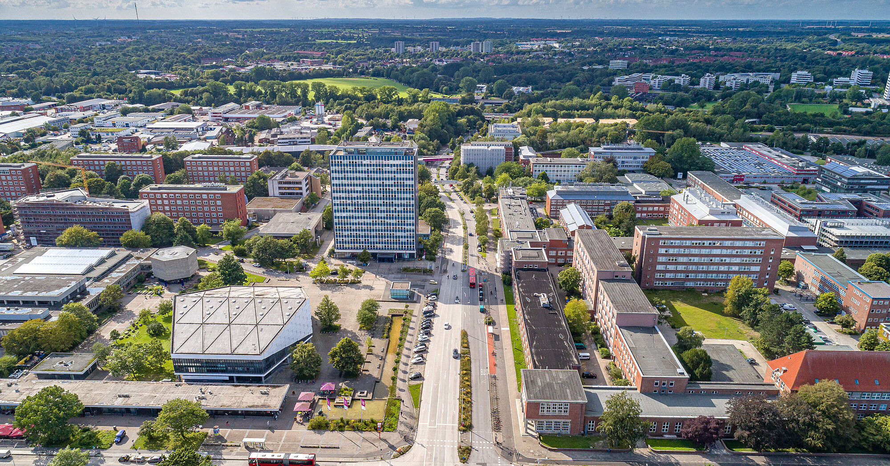
Studying at the University of Kiel
Facts
> 27.000 Students
8 Faculties
190 Study Courses
Part of the SEA_EU
A lot of Erasmus Students
A lot of Marine Science going on
https://www.uni-nordverbund.de/en/studieren/studienorte/universitaet-kiel/
https://www.uni-kiel.dde/de/karriere

Slide 6
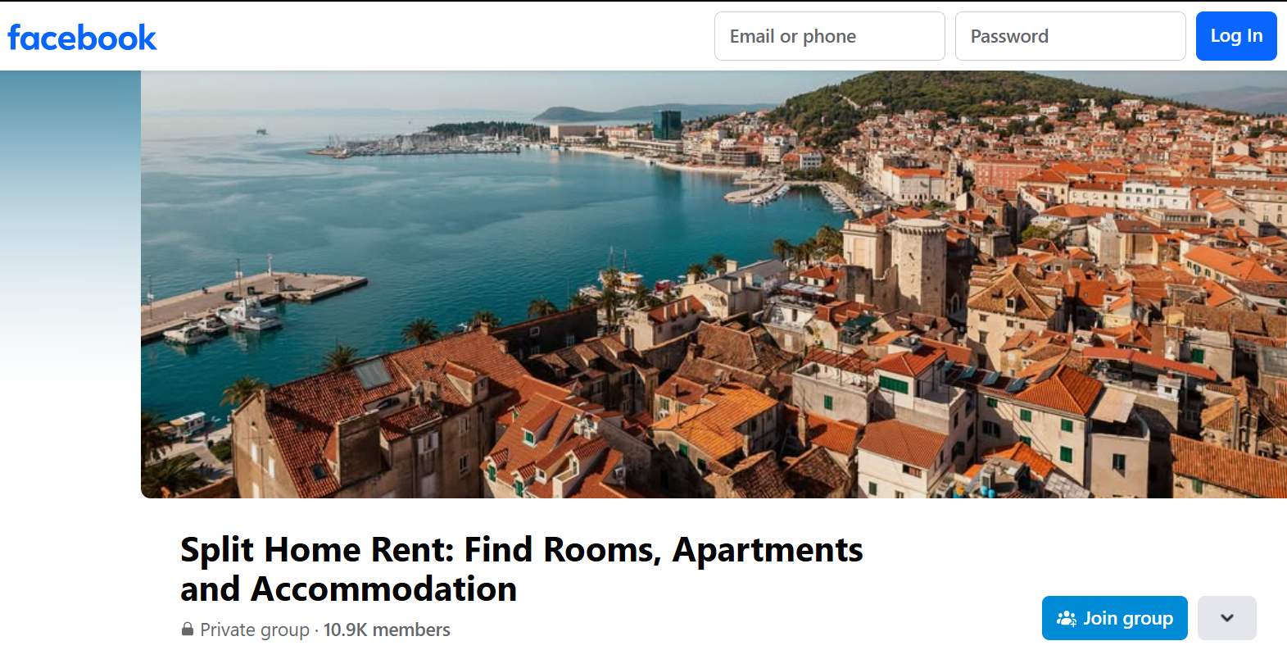
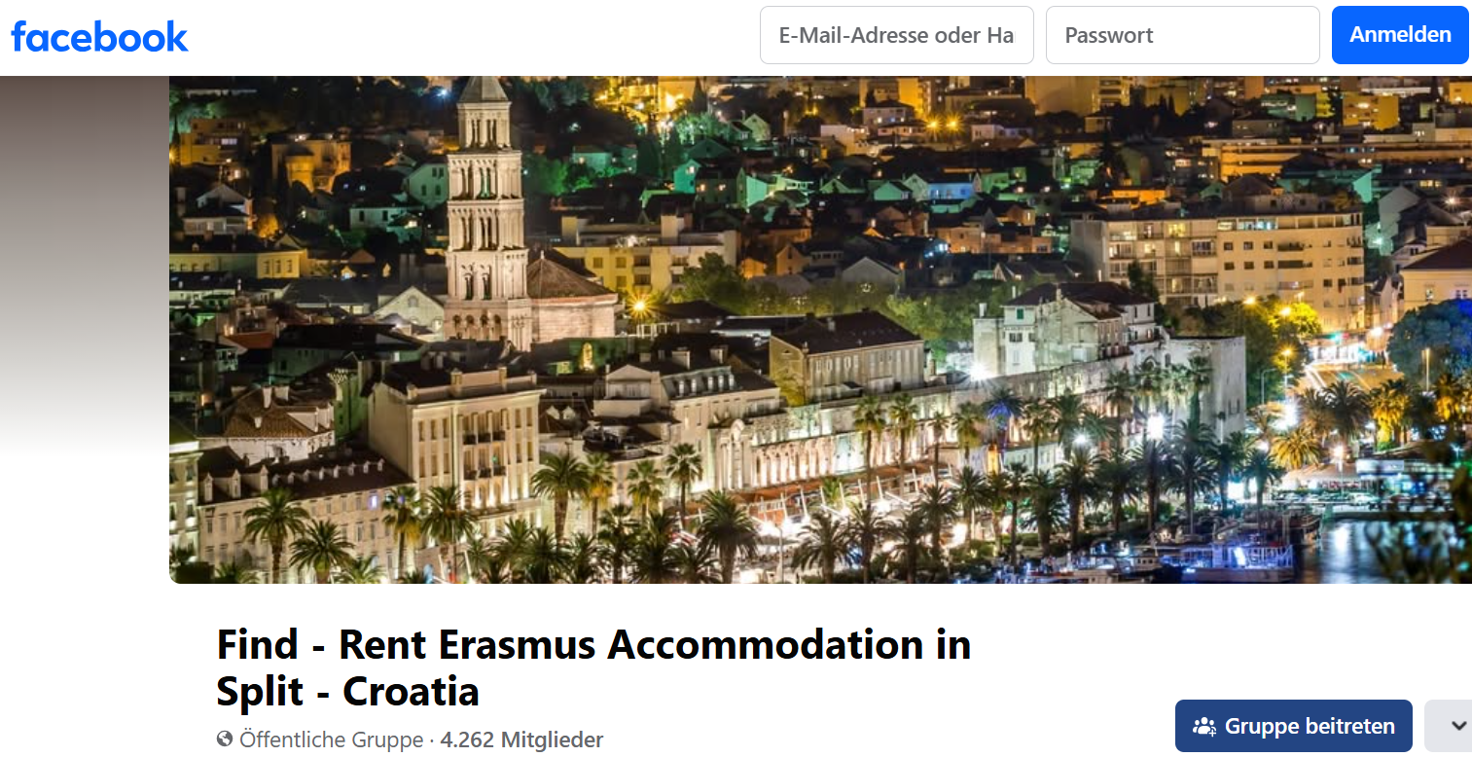

But if you do Erasmus…
Take care of not getting scammed!!!
Contact the local ESN* in advance
*ESN = Erasmus Student Network

Slide 7
My Bachelor Thesis*
2
*Using Image Embedding Similarity Measurements for Clustering Fixed Gear Ship Trajectories

Slide 8
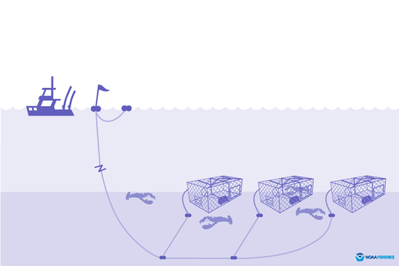
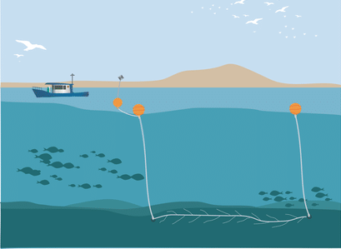
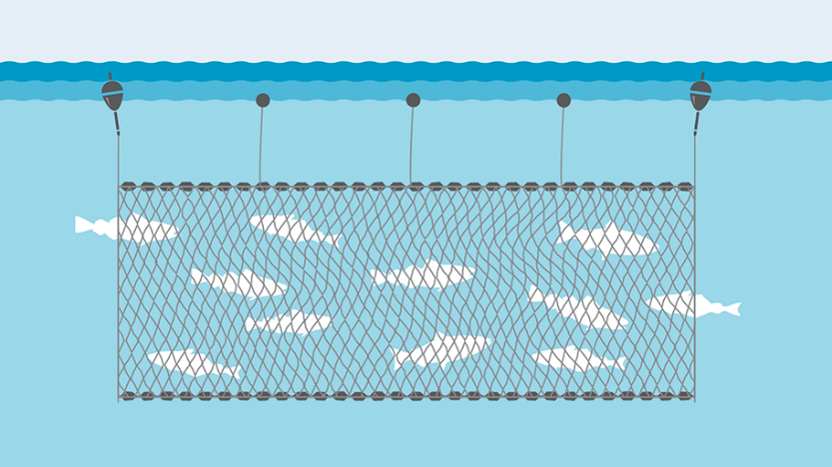
Motivation
Gillnetting is forbidden in the German Baltic Sea since 2021
https://www.msc.org/what-we-are-doing/our-approach/fishing-methods-and-gear-types/gillnets
https://www.fisheries.noaa.gov/national/bycatch/fishing-gear-traps-and-pots
https://www.researchgate.net/figure/Longline-fishing-in-the-Gulf-of-Mexico-a-Bottom-longlines-are-one-of-the-primary-gears_fig2_334744094
Gillnetting
(Stellnetze)
trapping / potting
Stationary longline

Slide 9
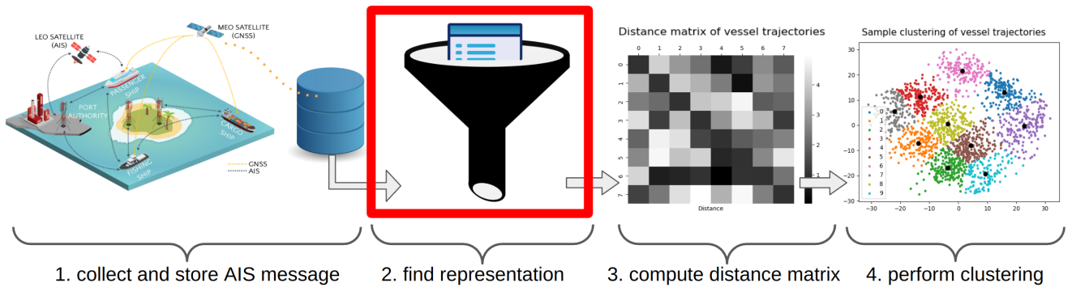
The Procedure
Find good metric to portray informations
K-means
Trajectory:
Timestamp / Distance from shore / distance from port / speed / course…

Slide 10
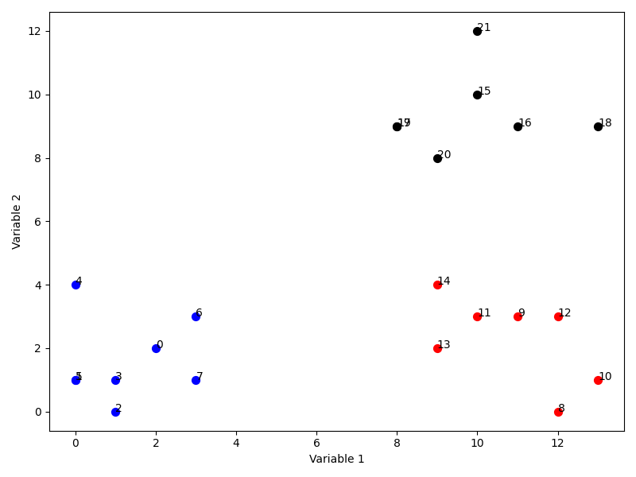
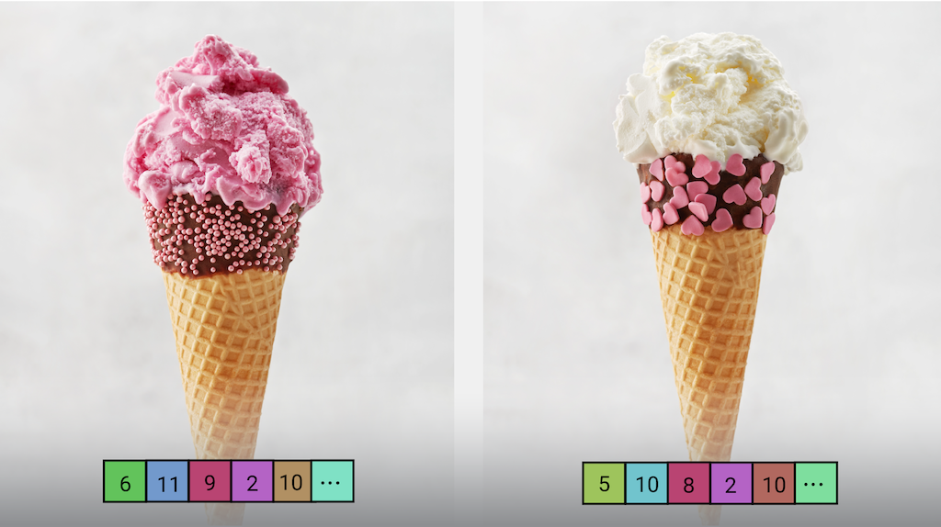
Metric and Clustering
Naming the Clusters
Potting
Gillnetting
Plotting
https://ai.google.dev/edge/mediapipe/solutions/vision/image_embedder
Stationary Longline
Using a CNN to extract Embeddings
Using K-means Clustering to cluster the Trajectories/Embeddings

Slide 11
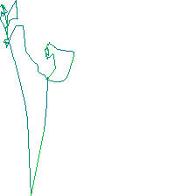
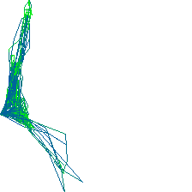
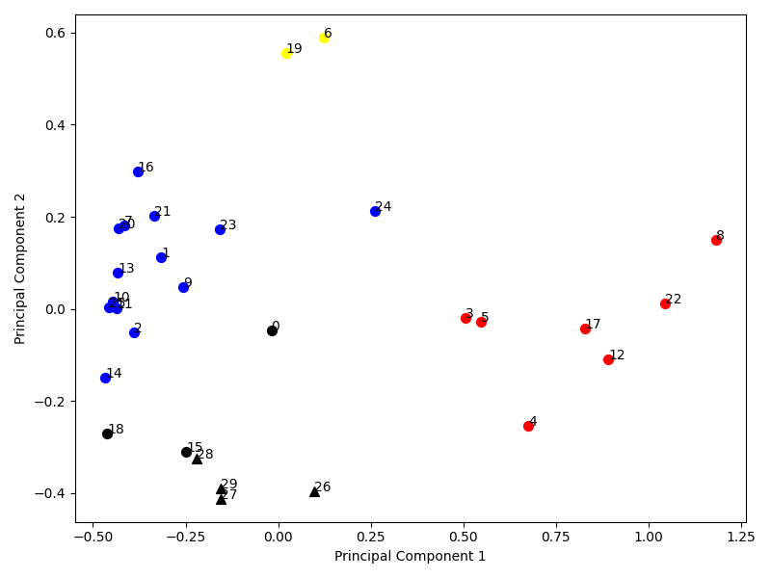
Implementation & Evaluation
Pictures of the Vessels trajectories
Lines colour indicates it‘s speed

Slide 12
Any questions so far?

Slide 13
My Master Thesis*
3
*Conversation Amplification through Language-based Reasoning and Generative Visual Content Creation

Slide 14
Introduction
Conversation Amplification through Language-based Reasoning and Generative Visual Content Creation
Using Llama to create the prompt for the image model.
Text-to-Text
Using an Image Model to create an image.
Text-to-Image

Slide 15

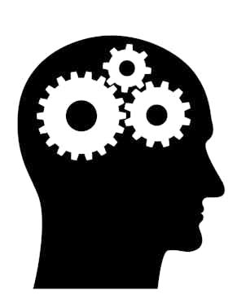

Idea
A Website recording the users conversation
Understanding the conversationg
Generating images based on the sayings
https://www.dreamstime.com/illustration/voice-recording-icon.html
https://theconversation.com/the-thinking-error-that-makes-people-susceptible-to-climate-change-denial-204607
https://theconversation.com/the-thinking-error-that-makes-people-susceptible-to-climate-change-denial-204607

Slide 16
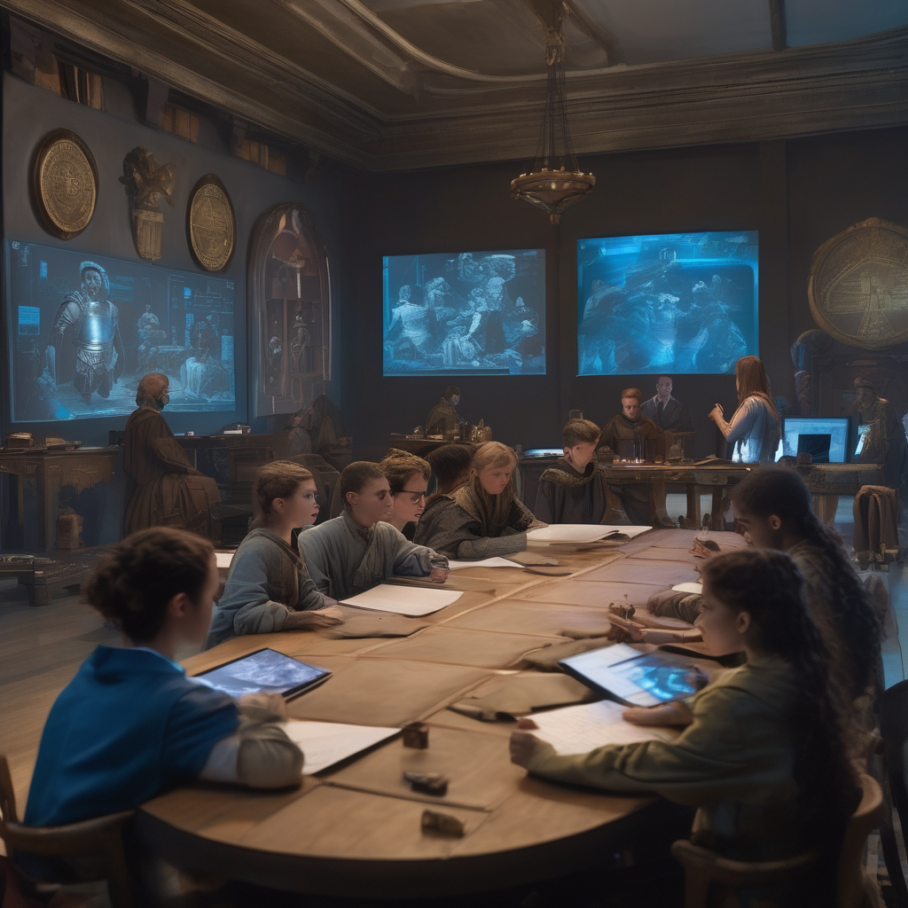
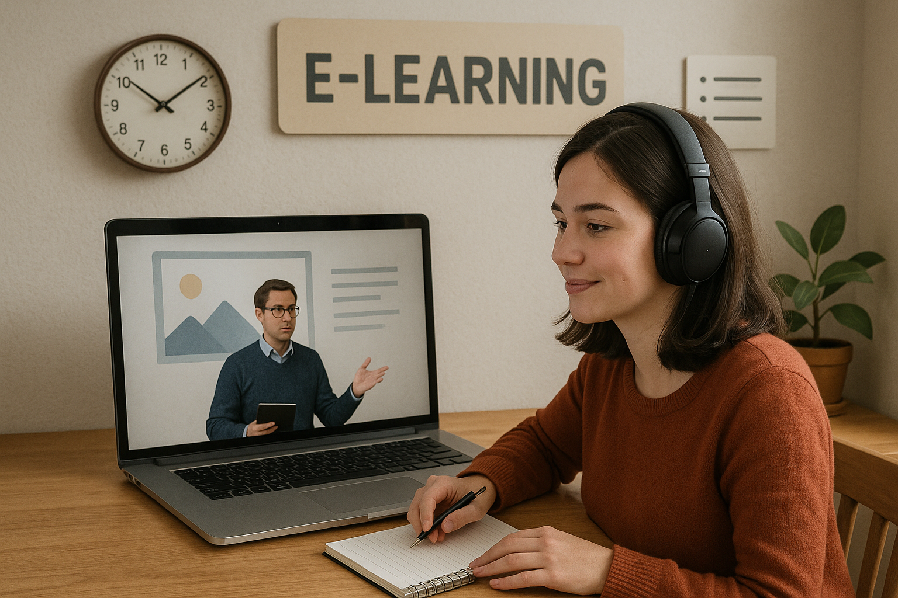
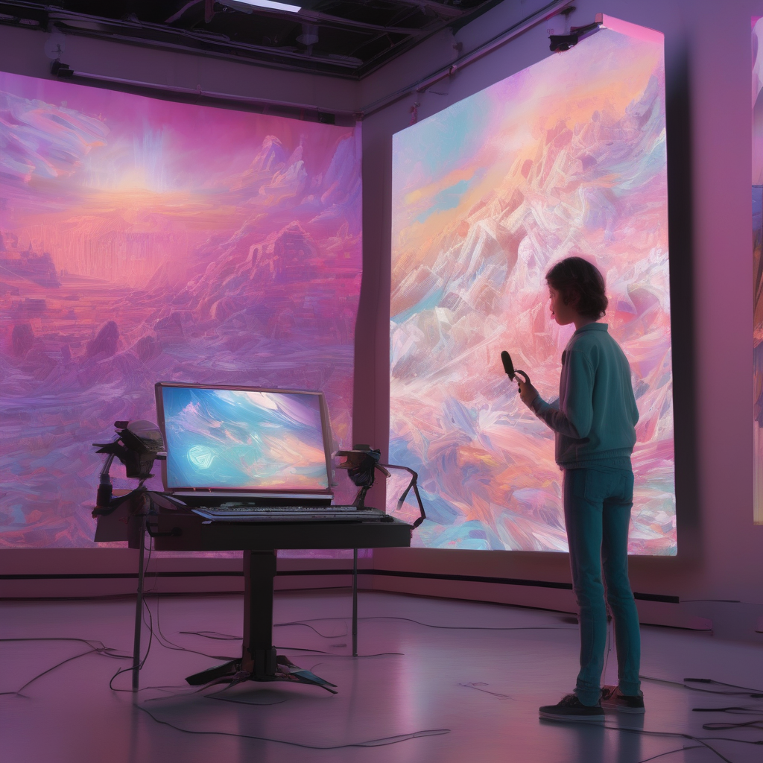
Motivation
Accessibility & Inclusion Visual Communication & Non-Verbal Language Translation
Education & E-Learning Visualize Learning Materials to support and enhance understanding
Boosting Creativity Artists could visualize ideas faster than ever before
*Images are AI generated

Slide 17




Architecture
Backend
(Flask)
Frontend
(Flutter)
Audio to Text
User
Fast Whisper
Audio recording
Library
Settings
Text-to-Text
LLM
Text-to-Image
Image Model

Slide 18
Whats next?
Evaluation
Features
“Conversation Amplification” needs to be evaluated and proofed!
→User tests…
Video Generation
→ Text-to-Video Model
Age Estimation & Sentiment analysis
Generating images depending on the user behavior
Specific Topic
Fine Tuning on a topic specific dataset

Slide 19
Another Project
4

Slide 20
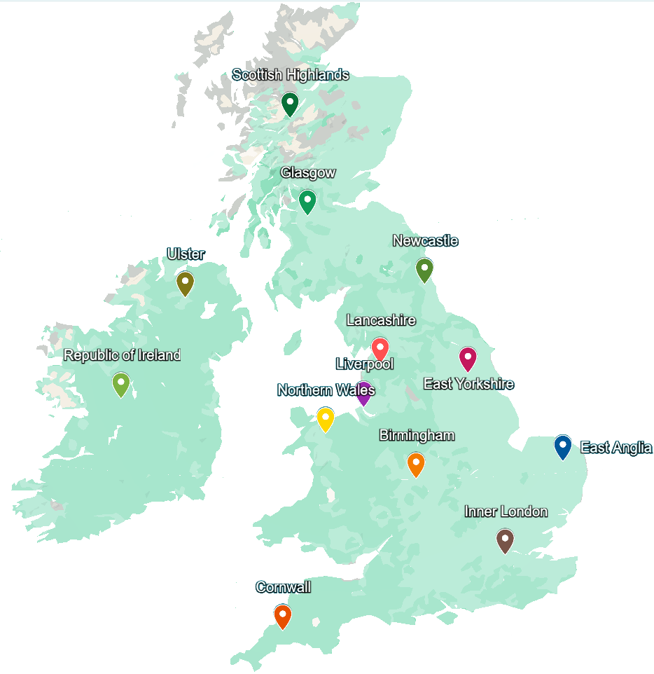
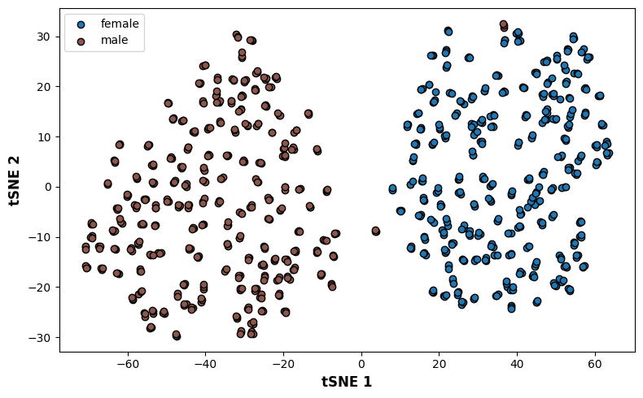
Exploring Speaker Voice Similarity Across British Accents using WavLM
A large Dataset of different British Accents
We applied a lot of NN techniques on it

Slide 21
My work in split
5

Slide 22
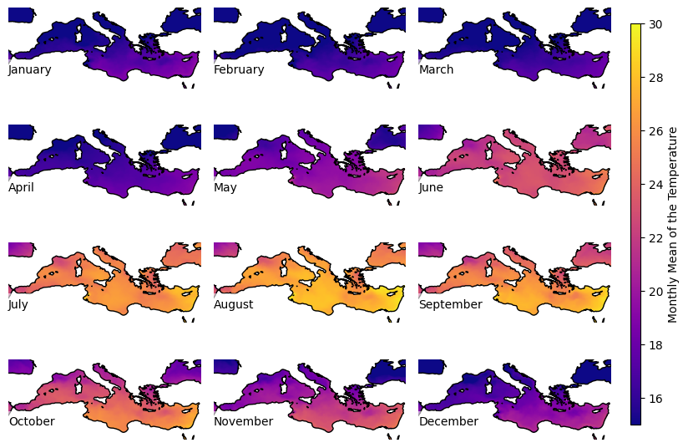
A Study of Spatial and Temporal Variability in the Mediterranean Sea
Analysing Temperature and other features over time
Predicting futuristic data
How reliable are predictions?
What, if there are some sensors missing?
Climate Change…?

Slide 23
Any Questions?
My Bachelor Thesis
My Master Thesis
Accent Analysis
My work in Split
Audio to Text
Fast Whisper
Text-to-Text
LLM
Text-to-Image
Image Model

Slide 24
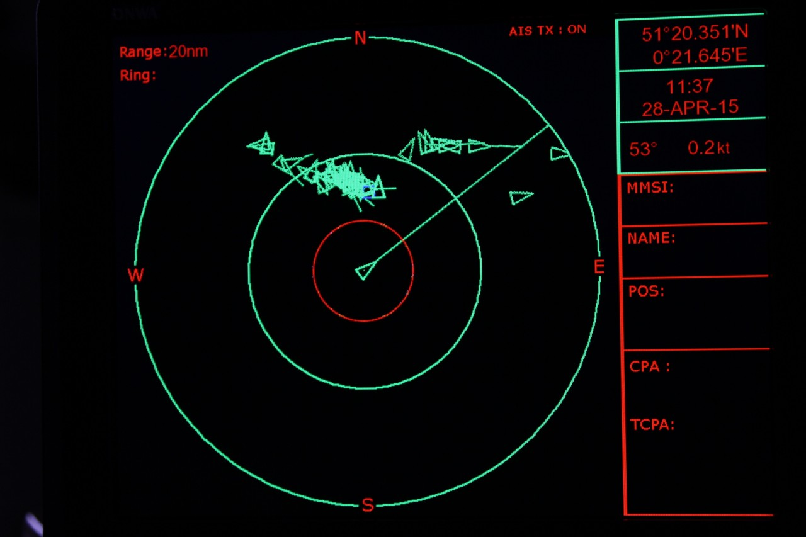
Dataset
Dataset contains a set of AIS messages
AIS is mandatory for all vessels*
One AIS message contains of:
ID
Location
Speed
Time
Distance from shore
Fishing right now?
…
Example of an AIS screen
https://www.maritimemanual.com/automatic-identification-system-ais/
But….
*from some size…

Slide 25
Introduction
Conversation Amplification through Language-based Reasoning and Generative Visual Content Creation
Using Llama to create the prompt for the image model.
Text-to-Text
Using an Image Model to create an image.
Text-to-Image

